Slide 1

Portable Cell Initiative
Project Overview

Slide 2
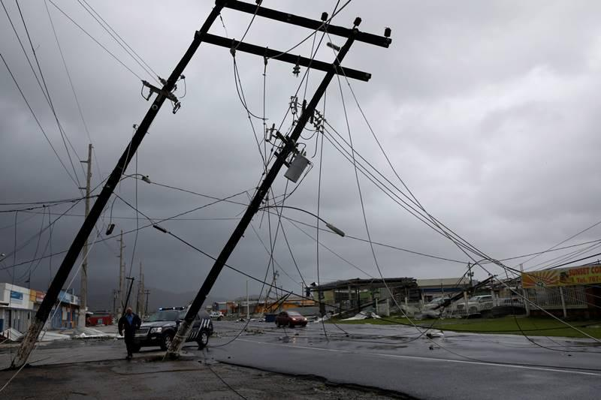
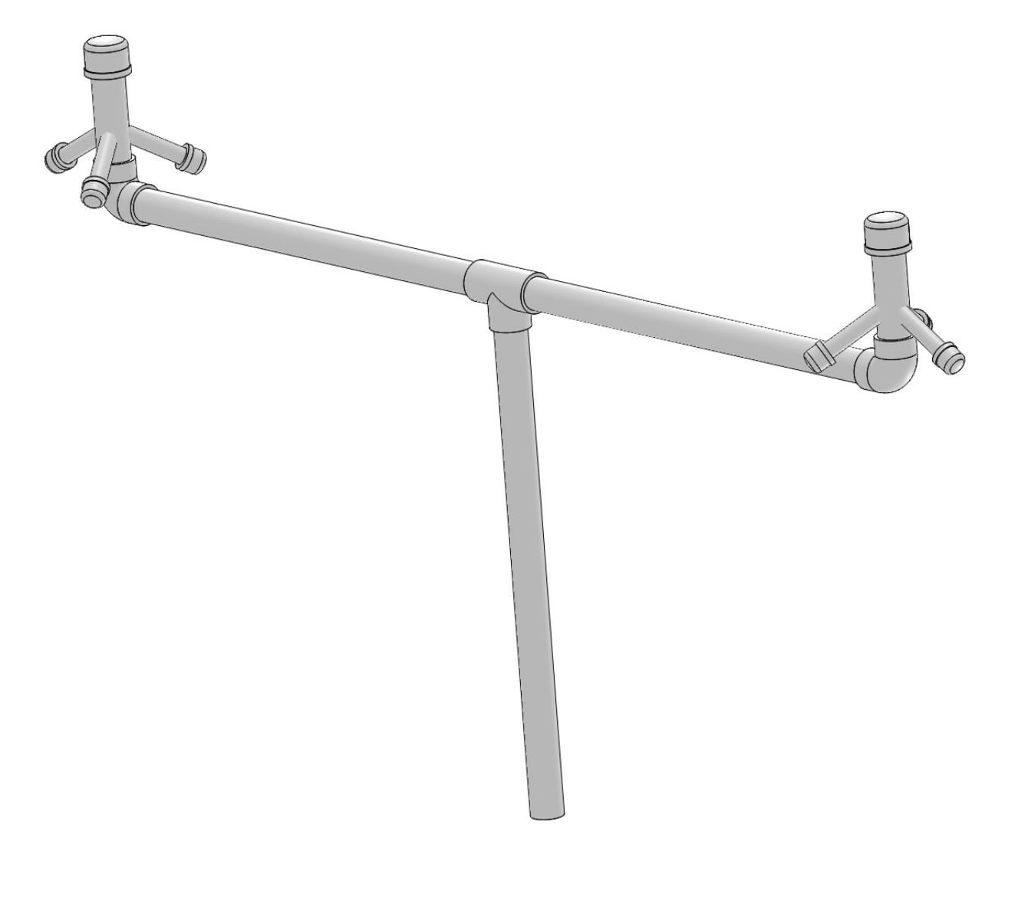
Overview
Extreme weather events like Hurricanes and other disasters
Hurricane Maria in Puerto Rico
Causes infrastructure failure and cellular network congestion
We need a solution that can reconnect those in need quickly, but can be powered by solar panels and generators
Small, portable cell towers
Allows any phone in the world to connect
Can operate independently of internet or carrier infrastructure
Portable Cell Initiative Radio Antenna Mast made from PVC

Slide 3
Business Model
Customers
Governments, Aid organizations
Users
Emergency workers, volunteers, local people
Competitors
Google Loon
Overcomplicated, requires dedicate ground equipment
AT&T ARMZ
Expensive, less portable, only for continental US
Value Proposition
Flexible
Low power
Quick to setup
Available for use in a diverse range of environments without modification

Slide 4
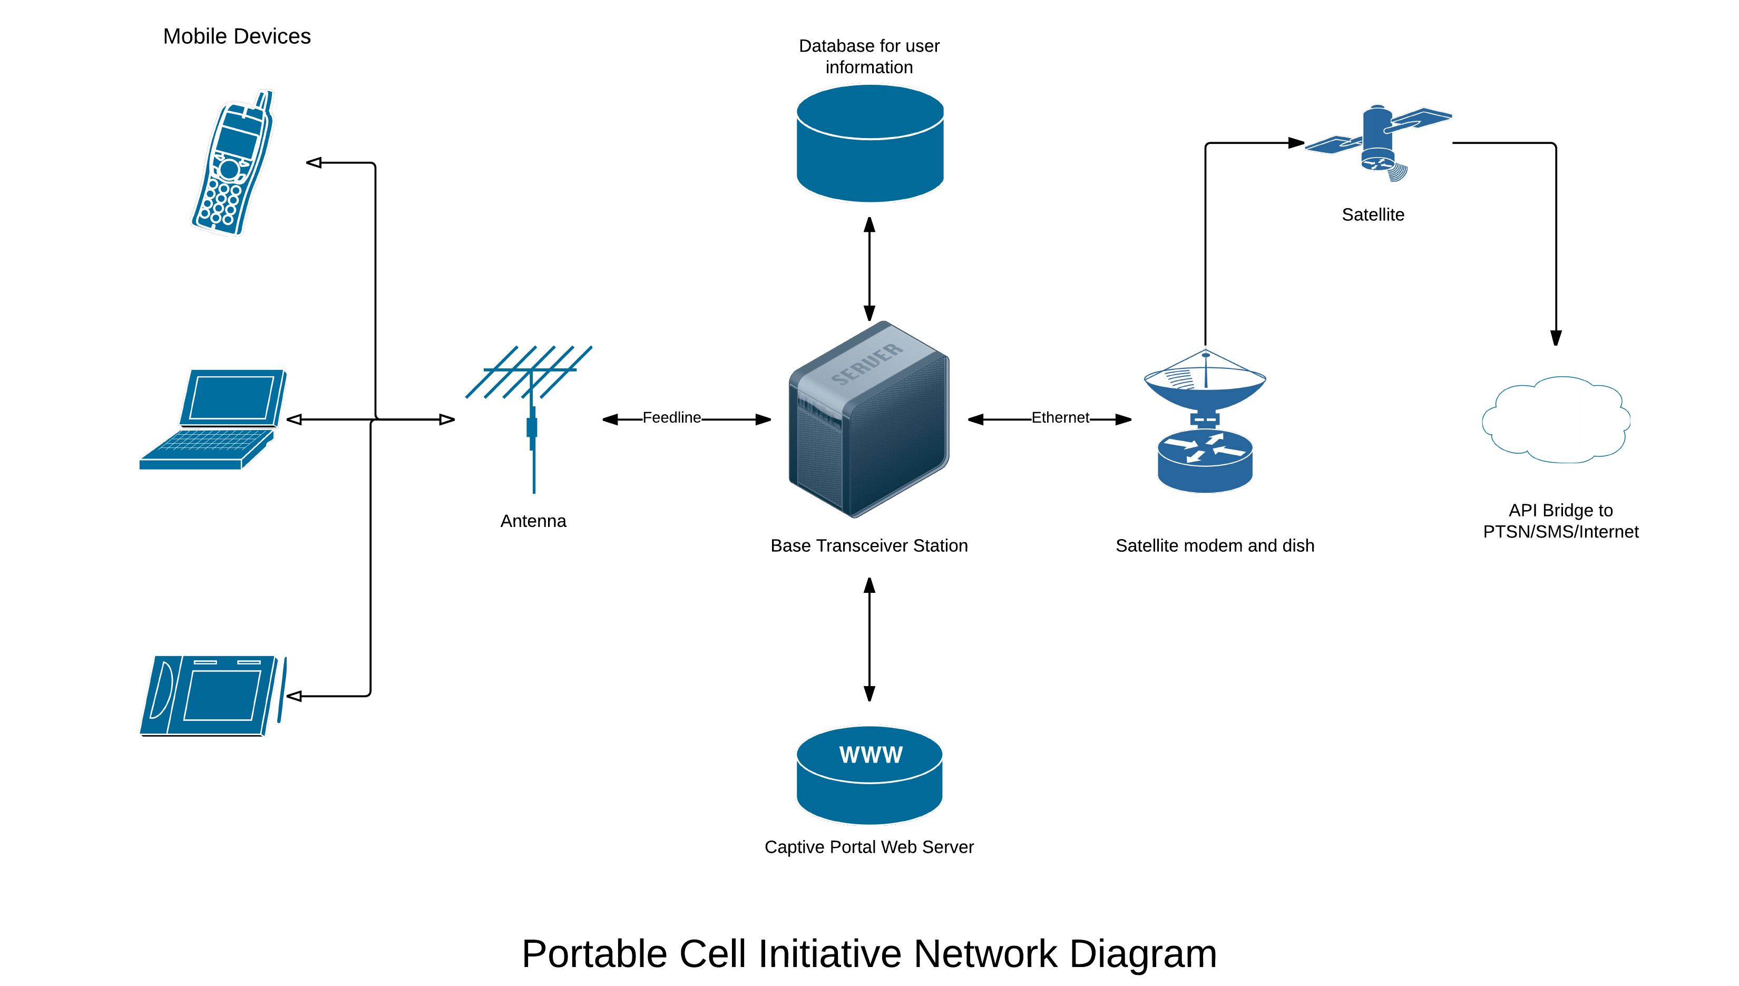
Design
The base transceiver station is the computers and radios that connect users to each other through the GSM protocol.
This connects to a database which keeps track of users and a web server that provides a captive portal to users when they first connect in their browser.

Slide 5
Features
Allows users to make calls, send SMS, access Internet
Connects to the outside world through a consumer satellite connection
Uses open source software and hardware
Software Defined Radio
OpenBTS software for GSM (2G) communications
Raspberry Pi or ODroid XU-4
Proven technology that is supported by volunteers all over the world
Flexible and adaptable to different environments
Open Registration
No new SIM Card required
Users are either added manually or register through SMS
Nearby microcells connect together to form a “mesh network”
Upgradable to 3G or 4G in the future
Can be set up and operated without technical expertise

Slide 6
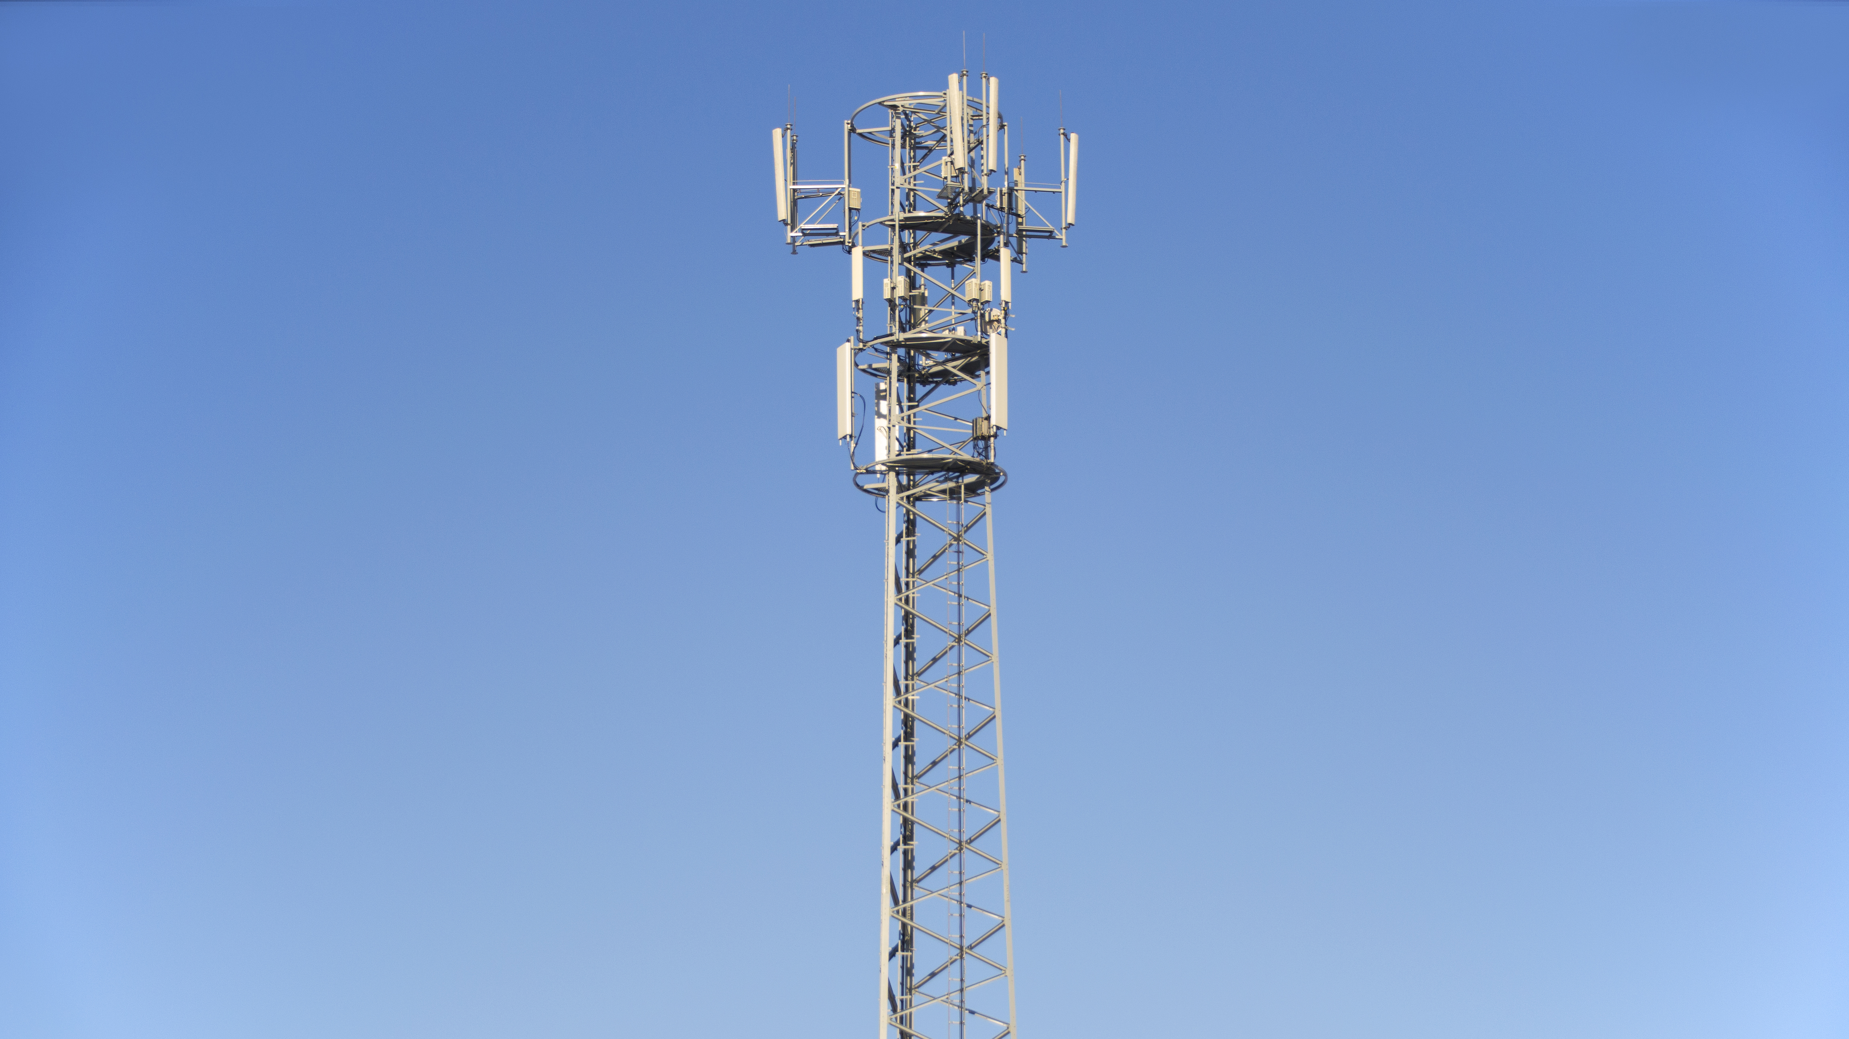
Web Portal
A default web page that appears upon connecting to the microcell’s network with a web browser
A common feature in large WiFi networks at hotels or airports
Provides official updates from the government or other emergency services
Has maps of surrounding area through Google Crisis Maps
Useful web resources and phone numbers to call
A forum for community peer-to-peer assistance

